Slide 1

Terp – Reddit Clone
By Jessica Fatal

Slide 2
High Level Overview
Terp - it is a mound that provides safe ground from other social media (even though it's just another social media website)
Purpose: create a website where user can post photos, videos or text, add friends, and interact with communities
Notes:
Terp (noun) : is an artificial dwelling mound found on the North European Plain that has been created to provide safe ground during storm surges, high tides and sea or river flooding.

Slide 3
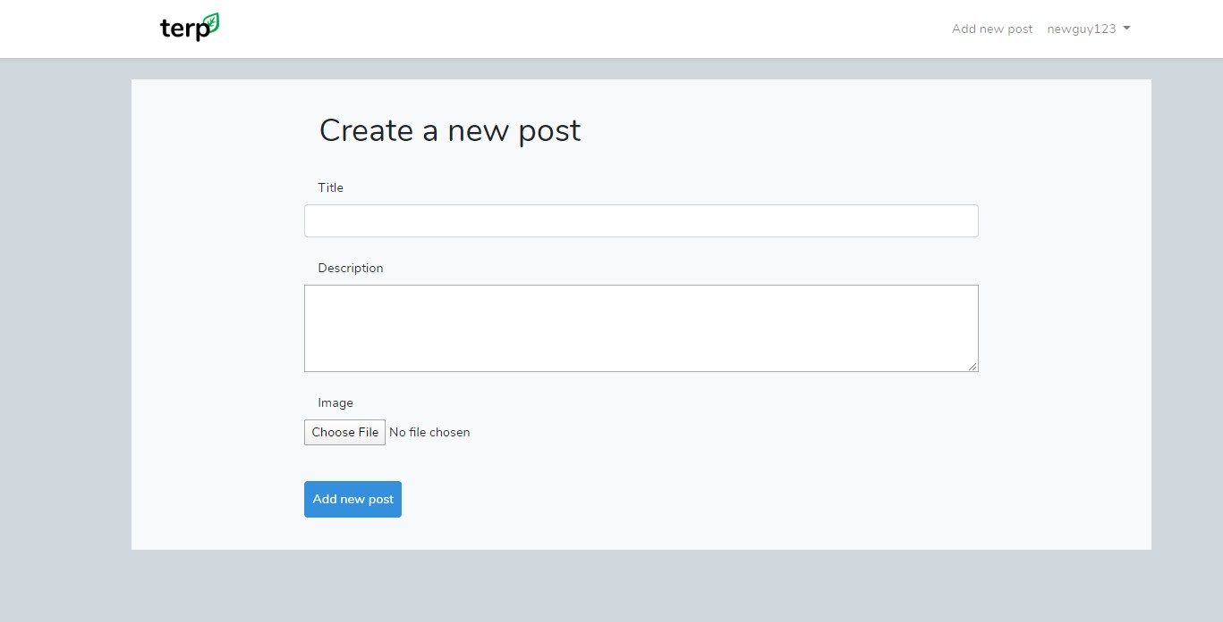
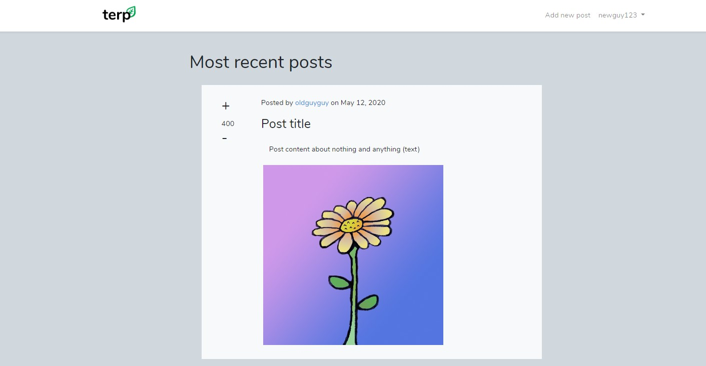
Current Features
Register user
Login
Add new post
User profile

Slide 4
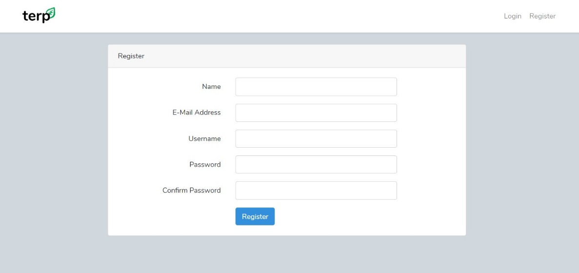
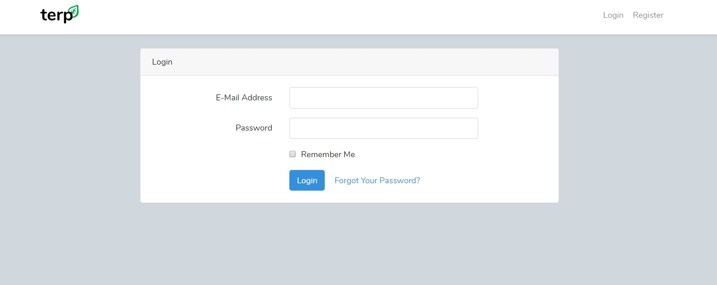
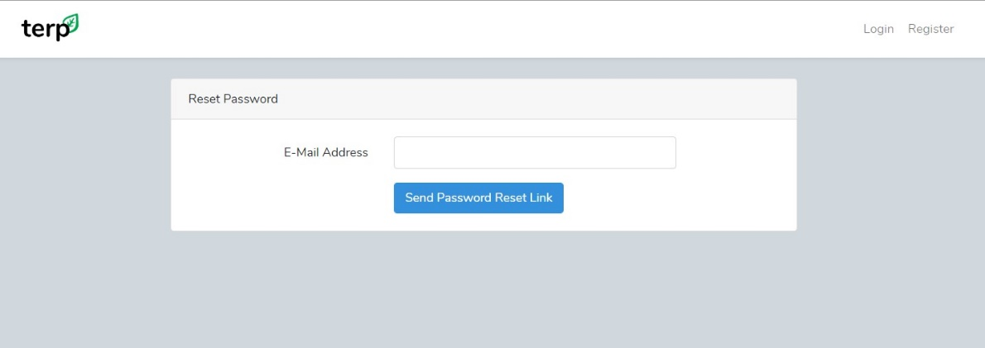
Current Features cont.

Slide 5

Challenges
Learning Laravel (7) independently
Using migrations to form database
Using PhpStorm as IDE
Relating what we learned (using slim, twig, etc.) to the Laravel framework

Slide 6

Challenges cont.
Learning to use command line for php artisan and tinker
Finding comprehensive documentation and up to date tutorials for Laravel 7
Partner left having not completed his work – had to start from scratch
Coronavirus????

Slide 7
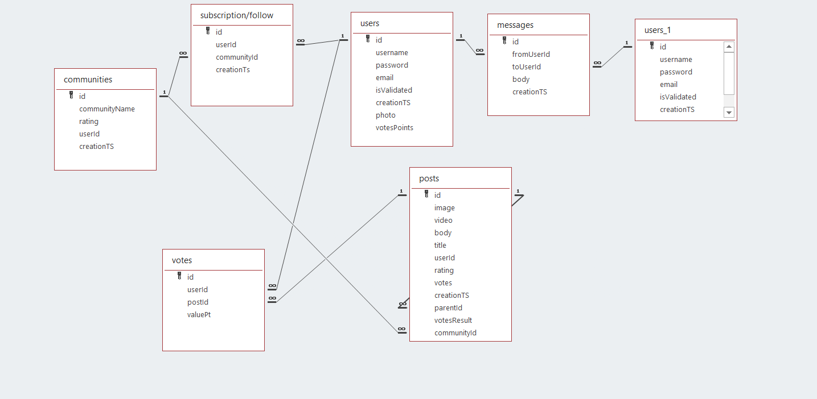
Database and Migrations
Before Laravel implementation
Create and modify database in phpMyAdmin

Slide 8
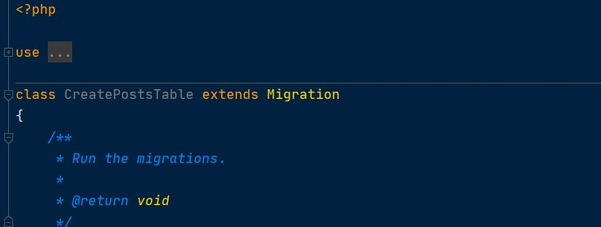
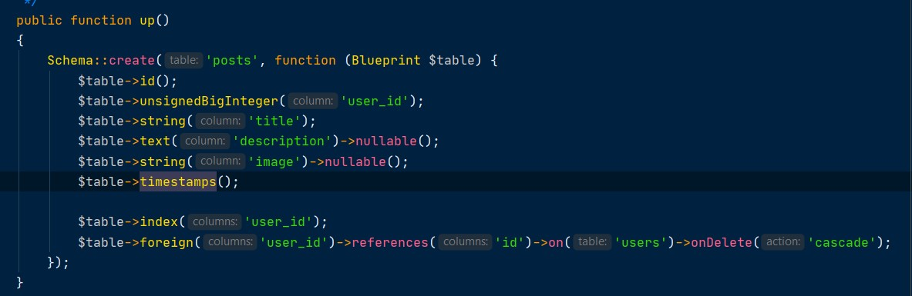
Solutions
Build database using migrations as project work continues
Simply add file that extends Migration in order to add tables
Modify migration file in order to add columns or modify table

Slide 9
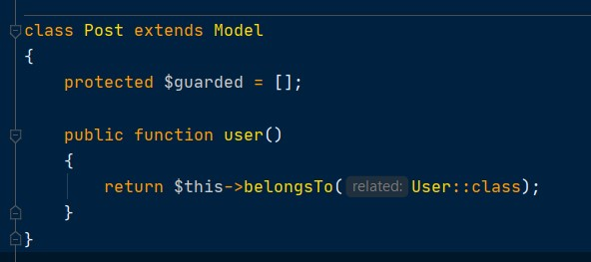
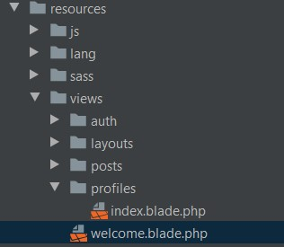
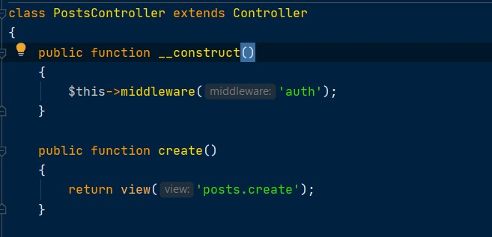
Solutions cont.
Model
Eloquent ORM
View
blade.php (instead of twig)
Controller

Slide 10
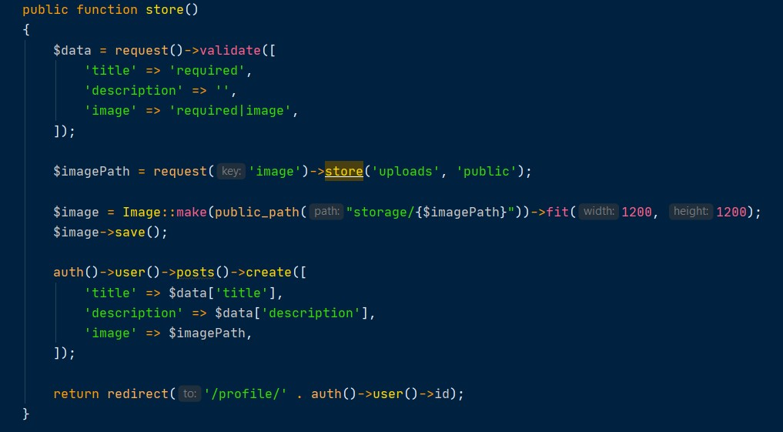
What I Learned
Adding validation and contoller modification is easy and straightforward
Controller can take care of redirection and storage

Slide 11
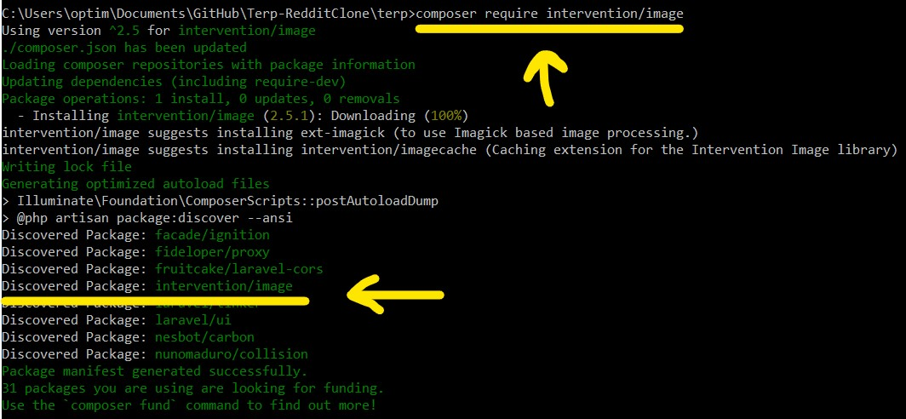
What I Learned cont.
Intervention/image to manipulate the upload (instead of resizing)
Auto-discovery; makes it easier to install and enable packages

Slide 12
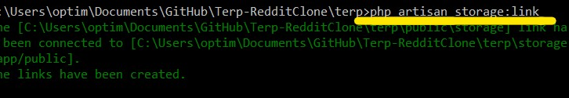
What I Learned cont.
Image automatically goes to "public/storage"
storage:link (php artisan) links "public/storage" to "storage/app/public" (allows access to user)

Slide 13
Future Work
Adding comments, posts with video
Google and/or Facebook login
Communities that user can create and modify (like subreddits)
Adding ratings to comments, posts, and users
Adding community schedule for events

Slide 14
Thank you!

